Slide 1

N-Body Simulation
Fabian Hölzl, Nicolas Sierra Manrique
Technische Universität München
Garching, 03. July 2025

Slide 2
Outline
Introduction to N-Body Problems
Physics for Stellar Systems
Interaction Methods
Position Integration Methods
Nvidia’s N-Body Algorithm
Code Samples
Performance
Visual Examples

Slide 3
Introduction to N-Body Problems
Multiple bodies interacting with each other based on some physical law or model
Examples:
Gravitation
DNA interactions
Protein folding
…
Our system:
Collisionless gravitational system of mass points in 3D space

Slide 4
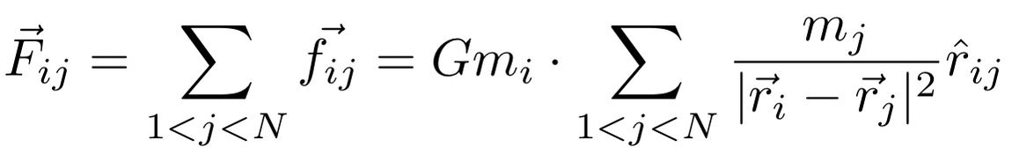
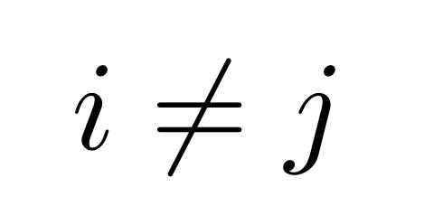
Physics for Stellar Systems
The Total force on a body I due to the interactions with other N-1 bodies :

Slide 5
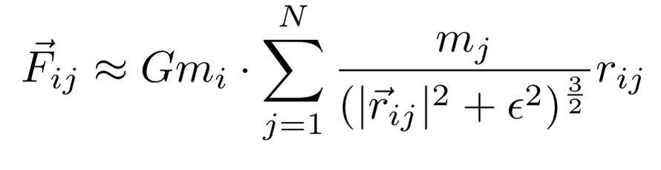
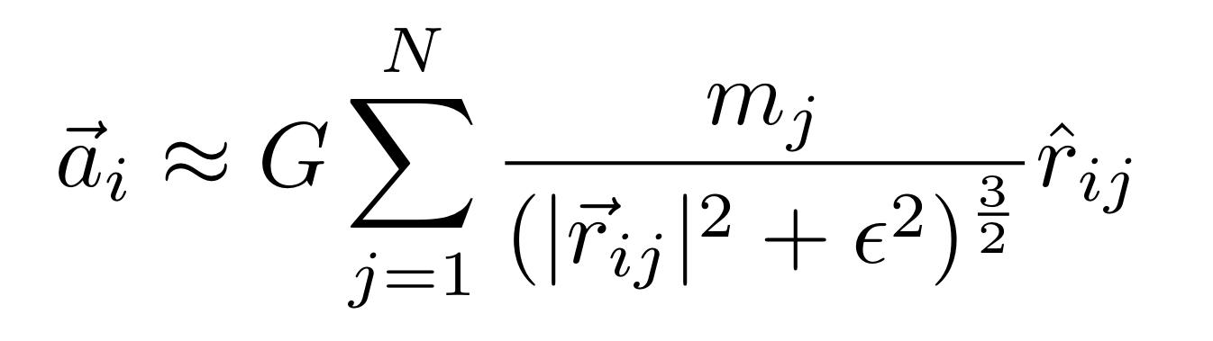
Physics for Stellar Systems
We include the softening factor \epsilon, limits the magnitude of the force:

Slide 6
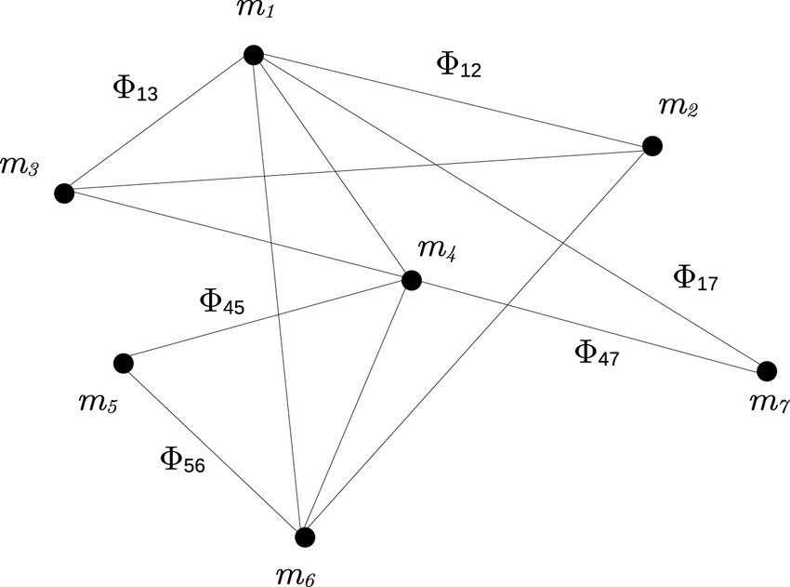
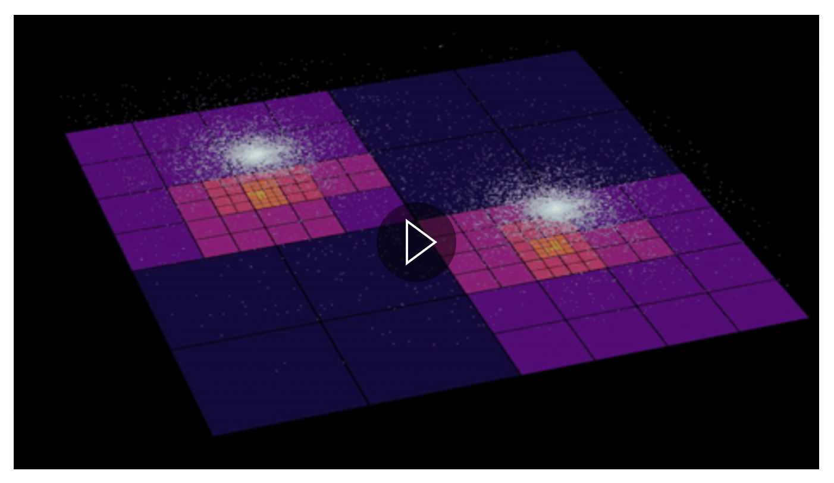
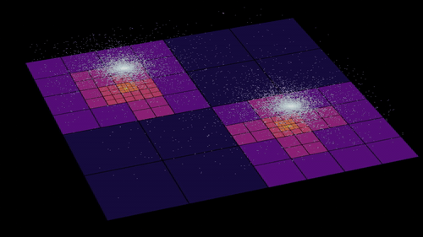
Interaction Methods
All-pairs method
Barent-hut
Notes:
Barent-hut:
-Space devided into cubic cells
-nearby particles treated individually
-distant cells treated as mass points in cells’ center of mass
Changing order from O(N²) to O(N logN)

Slide 7


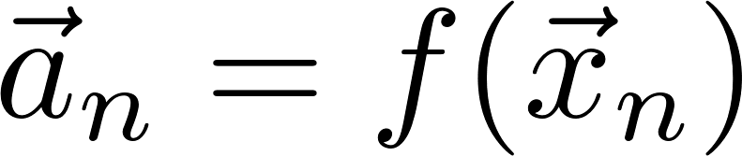
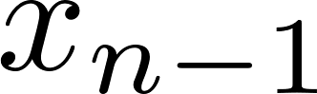

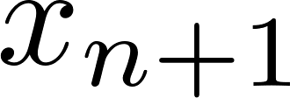
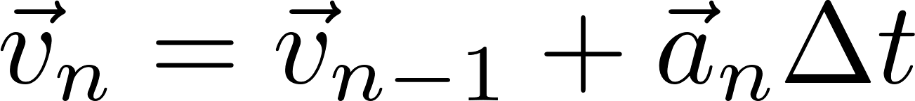
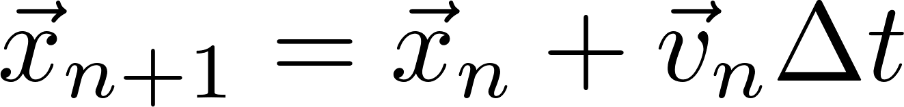
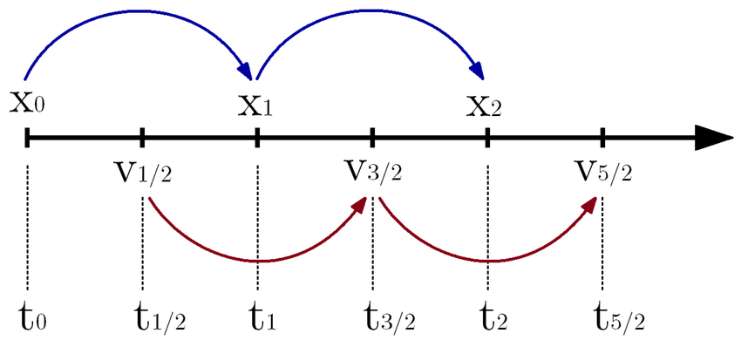
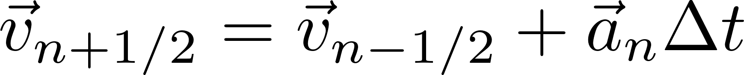
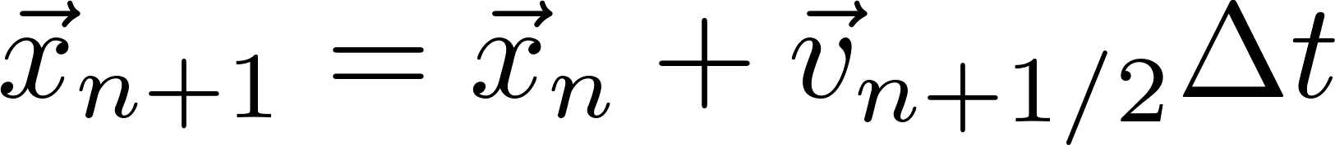
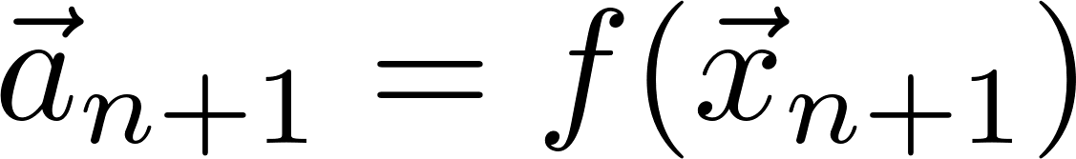
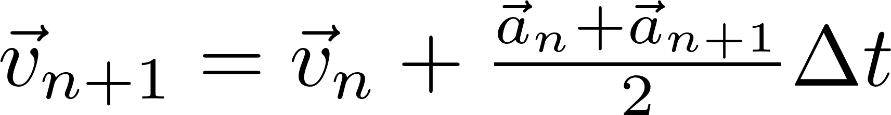
Position Integration Methods
2
1
Euler Method:
3
Leapfrog:
Velocity Verlet:

Slide 8
Nvidia’s N-Body Algorithm
sequential
All-pairs algorithm can be thought of as calculating each entry f _{ij} in an NxN grid of all pair-wise forces.
-> O(N²) available parallelism, but requires O(N²) memory
parallel
calculation particles
Solution: divide matrix in pxp tiles
p position descriptions
N
p acceleration descriptions
p updated accelerations
Thread sync and shared memory loading
N
interaction particles
Notes:
O[N^2] avaliable parallelism , this would required O[N^2] memory
Each acceleration description is in its own thread
Position description is in shared memory for all threads accessible
Each block has p threads running
Note:
Be aware that animation does not represent the real way threads are running through the matrix

Slide 9


Code Samples

Slide 10
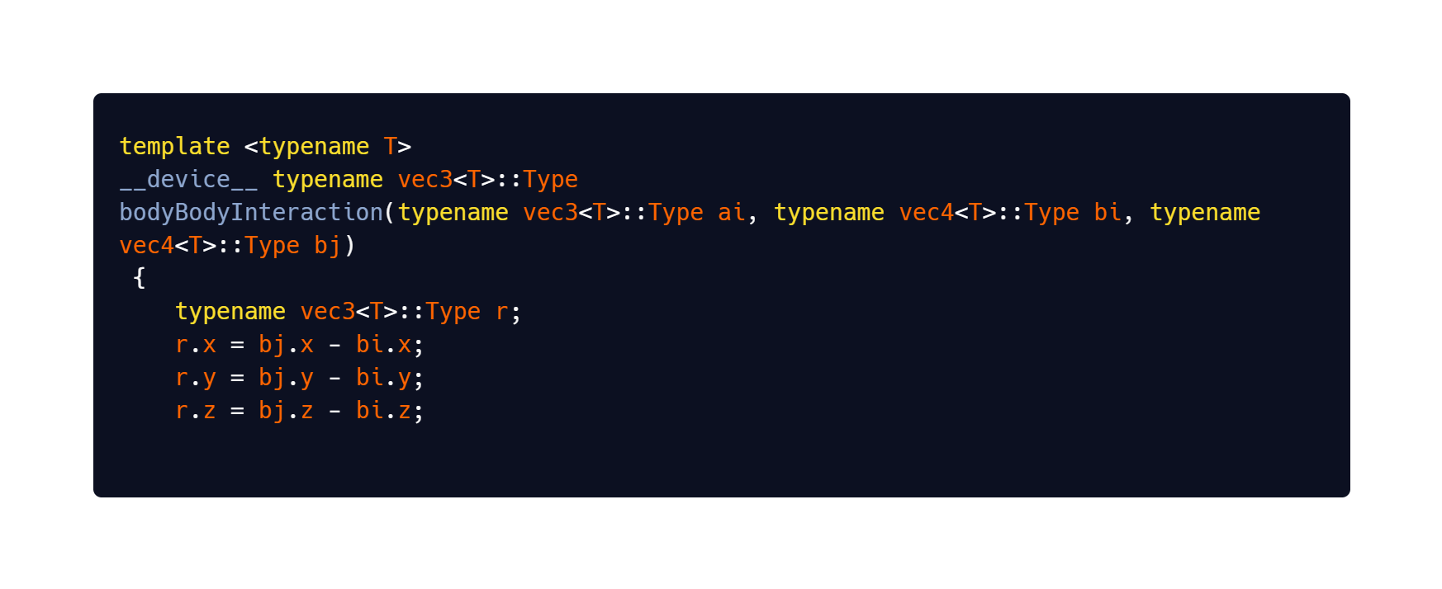
How does the NVIDIA code work?
First we need to calculate the acceleration :

Slide 11
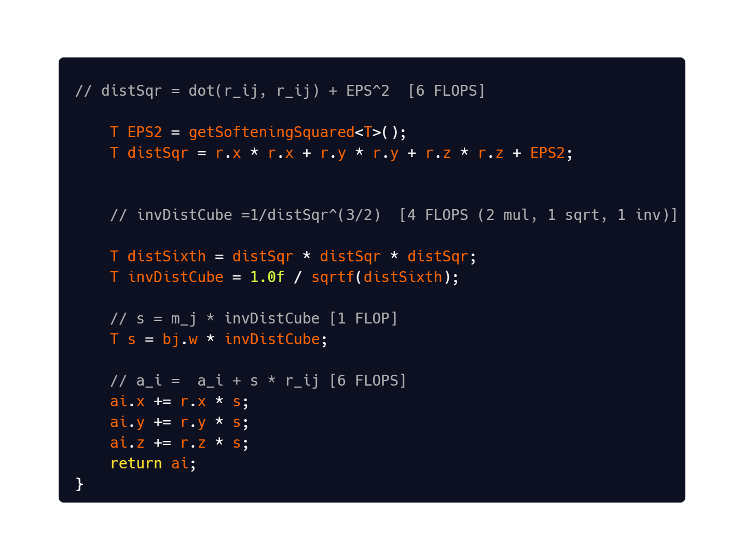
How does the NVIDIA code work?
First we need to calculate the acceleration :

Slide 12
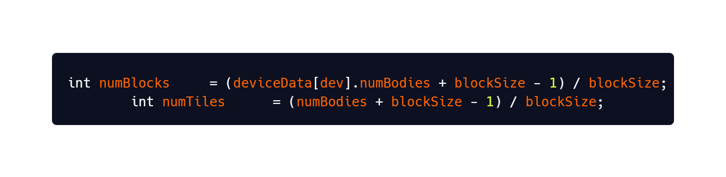
How does the NVIDIA code work?
Now we calculate the number of Tiles :
With the block size as our input, the number of tiles is calculated as integer from
The number of bodies and the blocksize

Slide 13
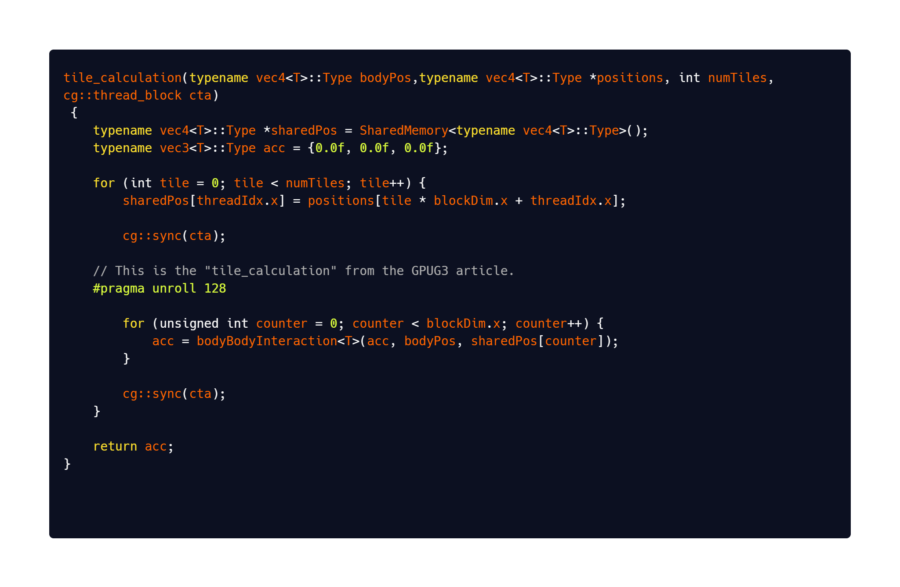
How does the NVIDIA code work?

Slide 14
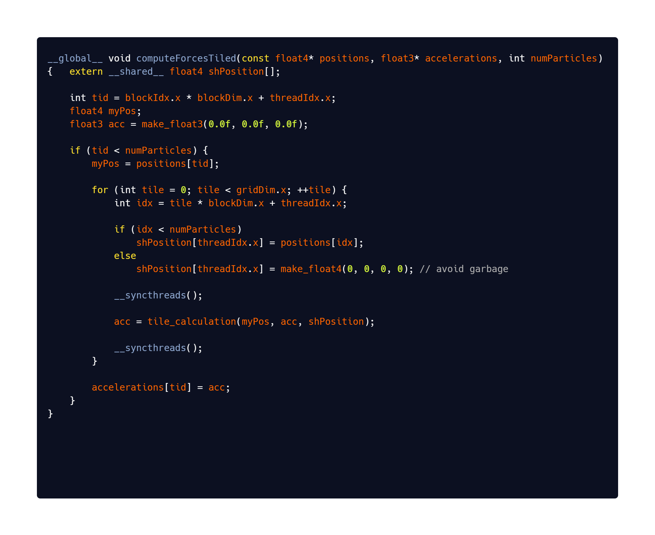
How does the NVIDIA code work?

Slide 15
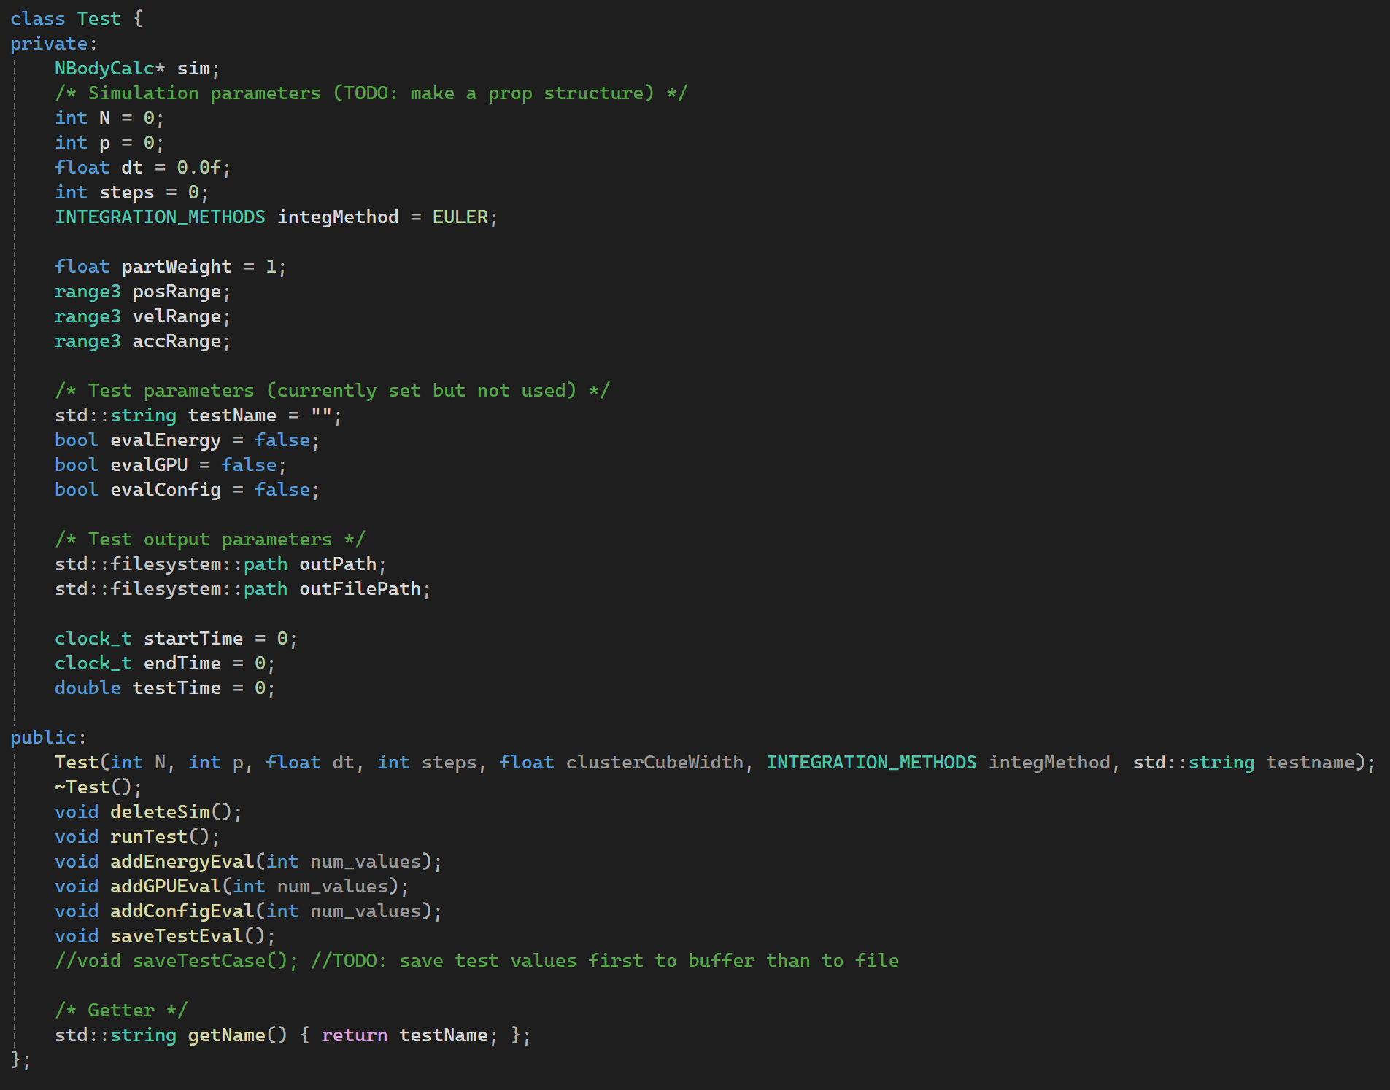
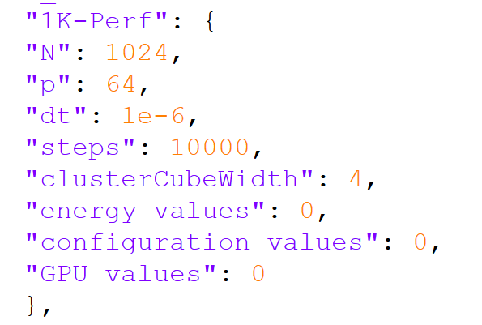
Own implementation:
Input:
- Define test case in json

Slide 16
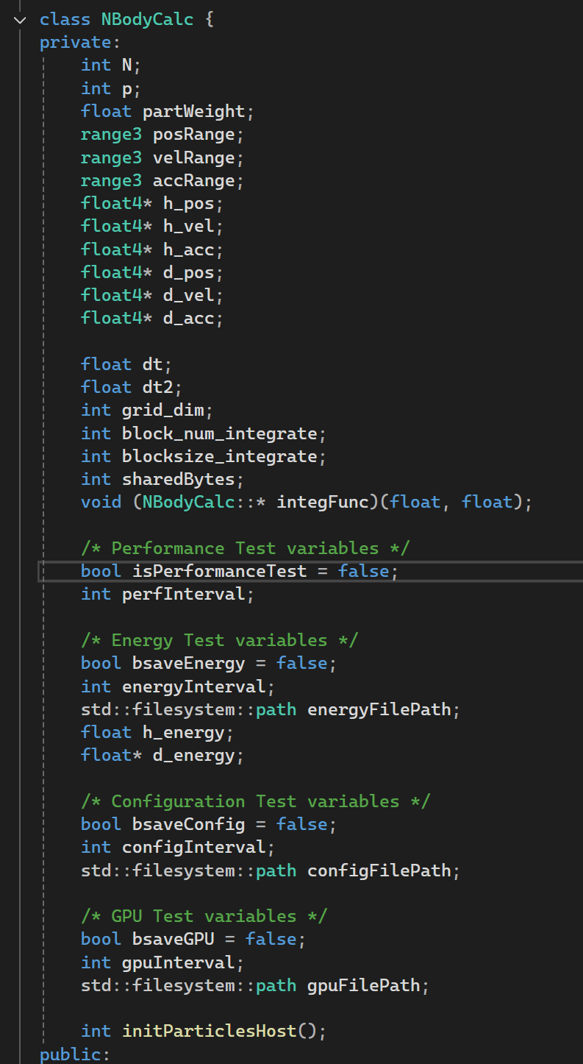
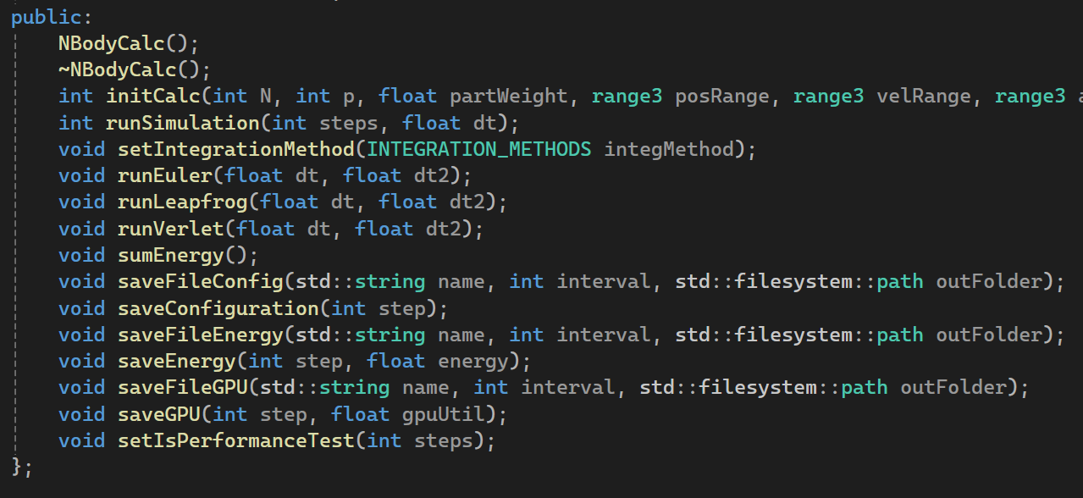
Own implementation:
Simulation class:

Slide 17
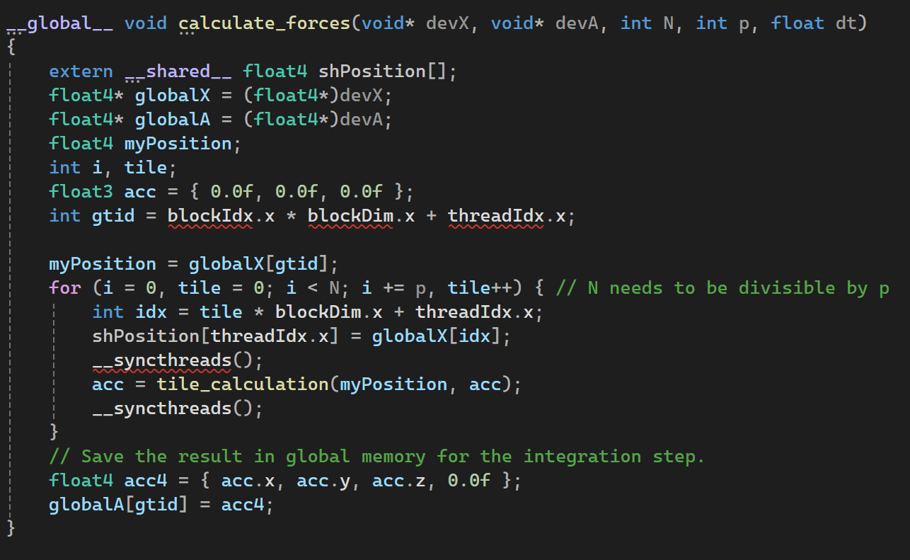
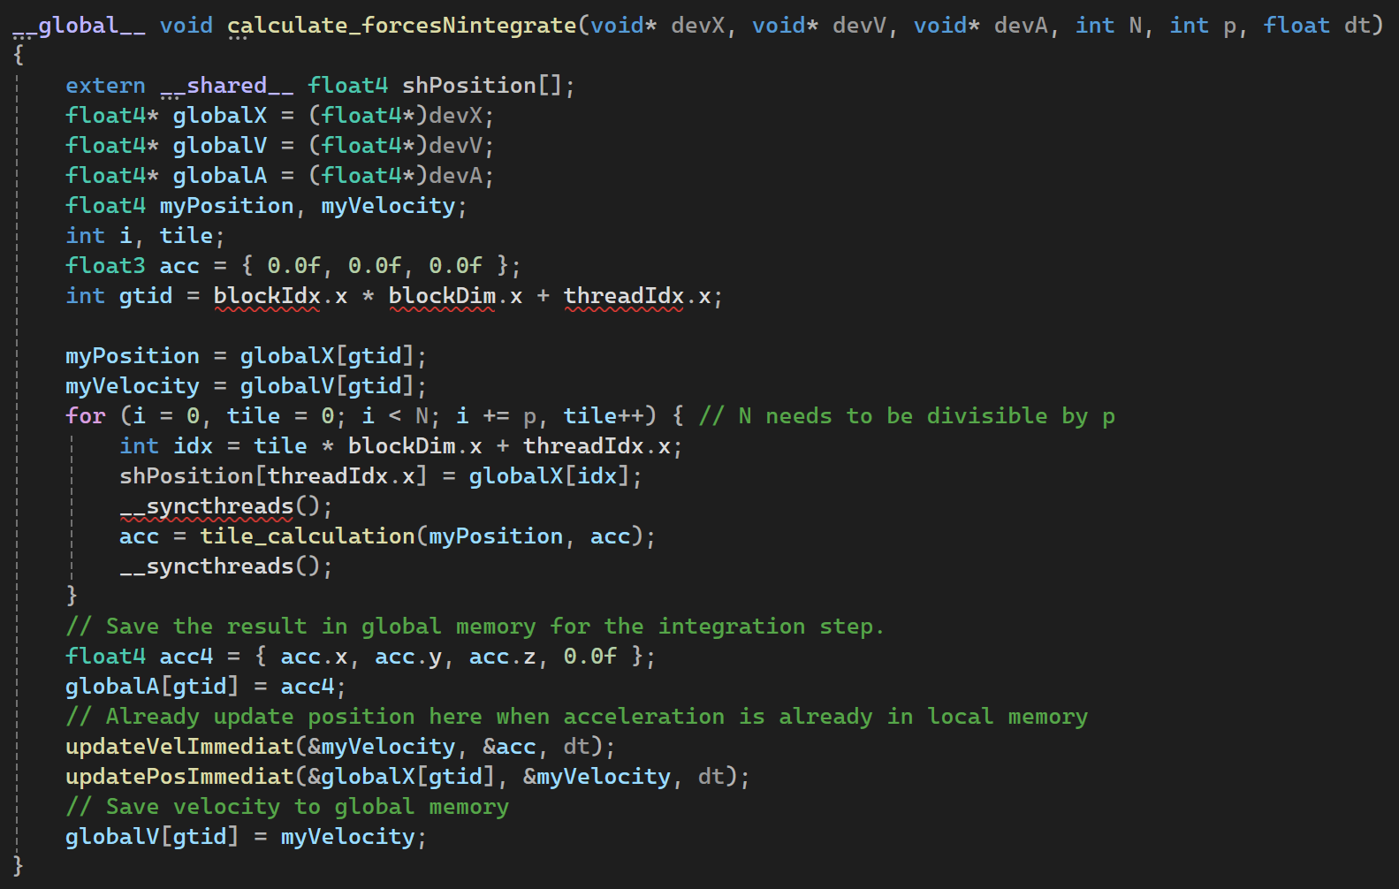
Own implementation:

Slide 18
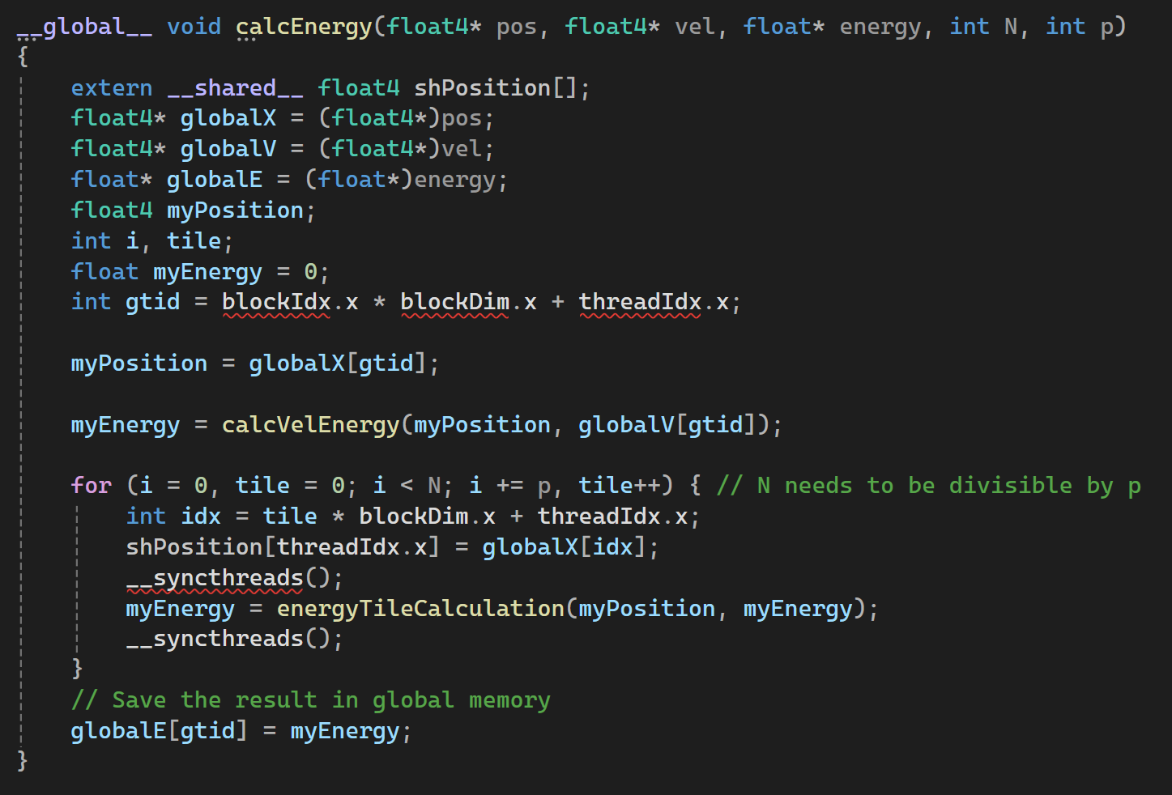
Own implementation:

Slide 19
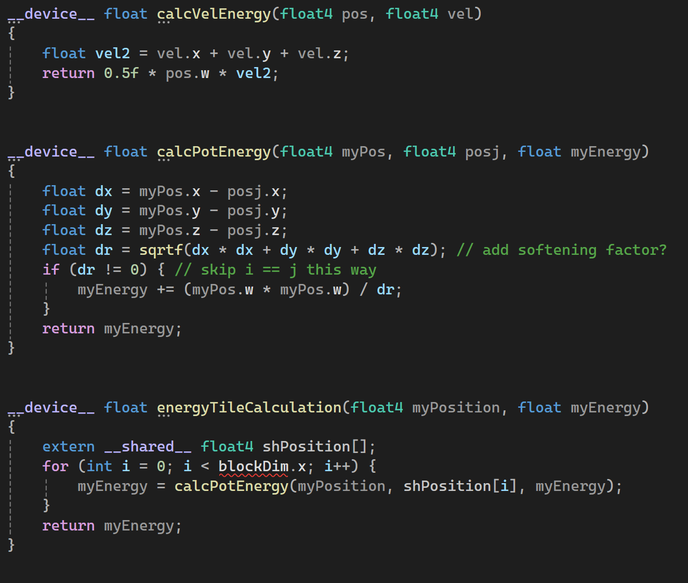
Own implementation:

Slide 20
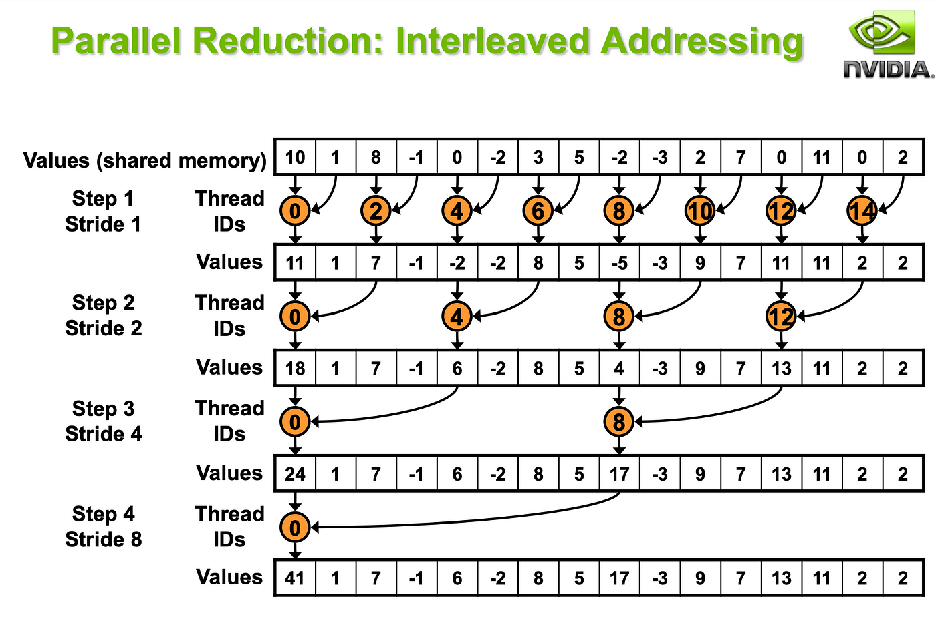
Own implementation:

Slide 21
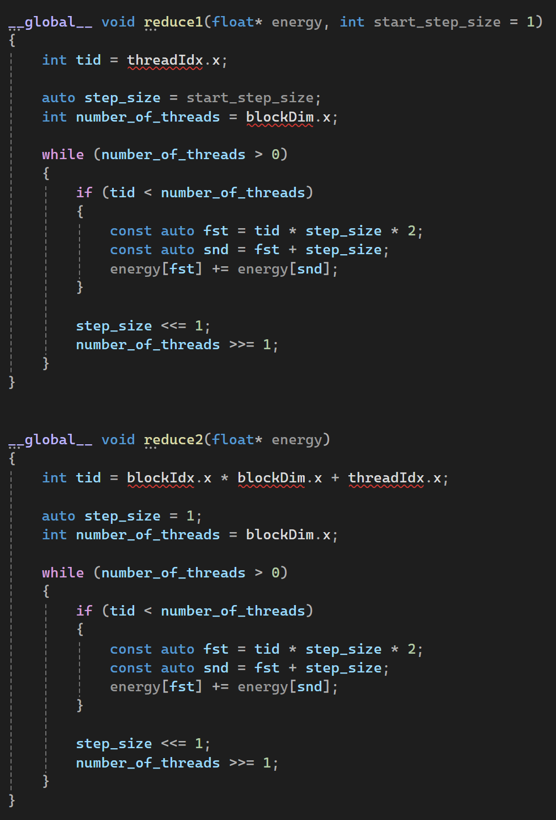
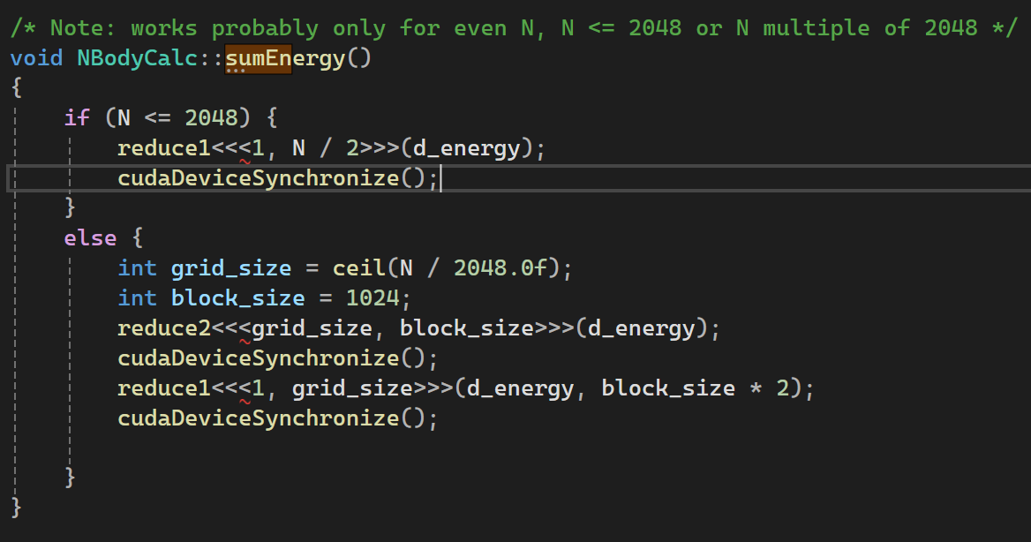
Own implementation:

Slide 22
Performance
Nvidia provides a code to measure the performance of the n-body simulation
There are two parameters:
Time for 10 interactions
GFLOPs per second (Each interaction has 20 Flops)

Slide 23
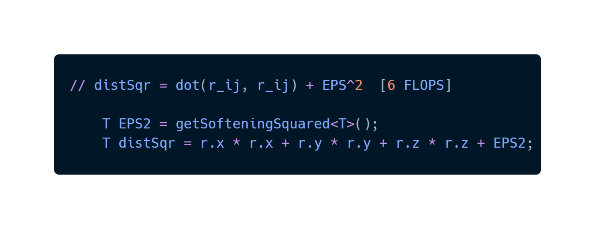
WTF is a FLOP ?
A Flop is a funny Name for an operation, for example: a multiplication, a sum, a root squared

Slide 24
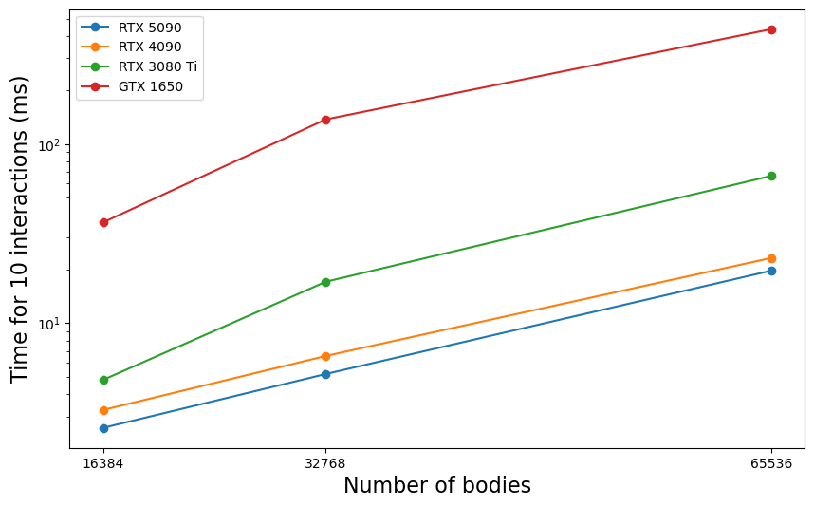
Performance comparison between GPUs
Nvidia Code

Slide 25
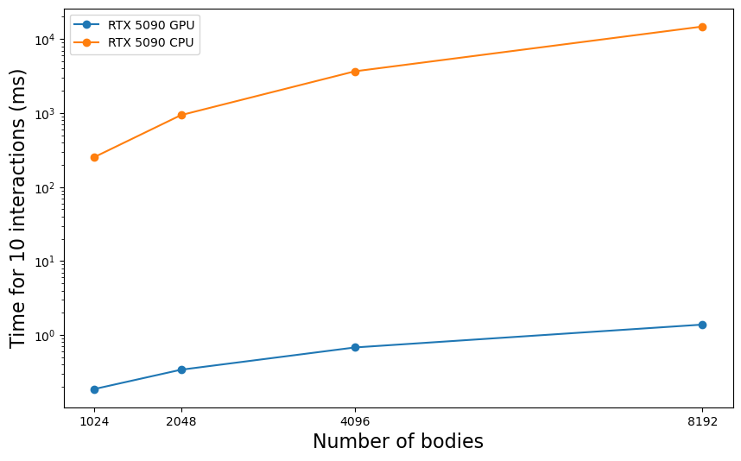
Performance comparison between GPU and CPU 5090
Nvidia Code

Slide 26
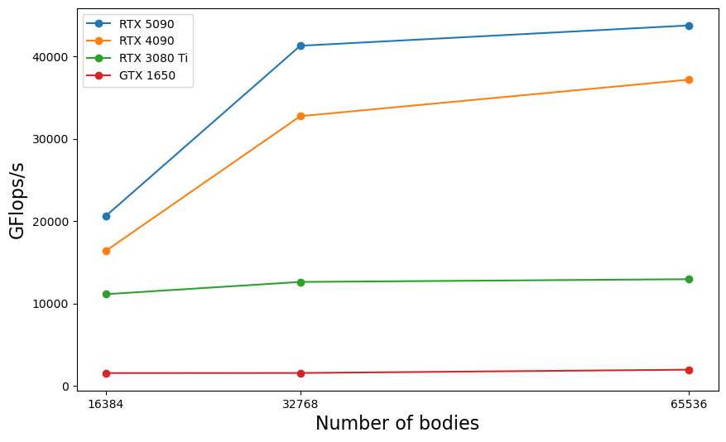
Performance comparison between GPUs in GFLOPs
Nvidia Code

Slide 27
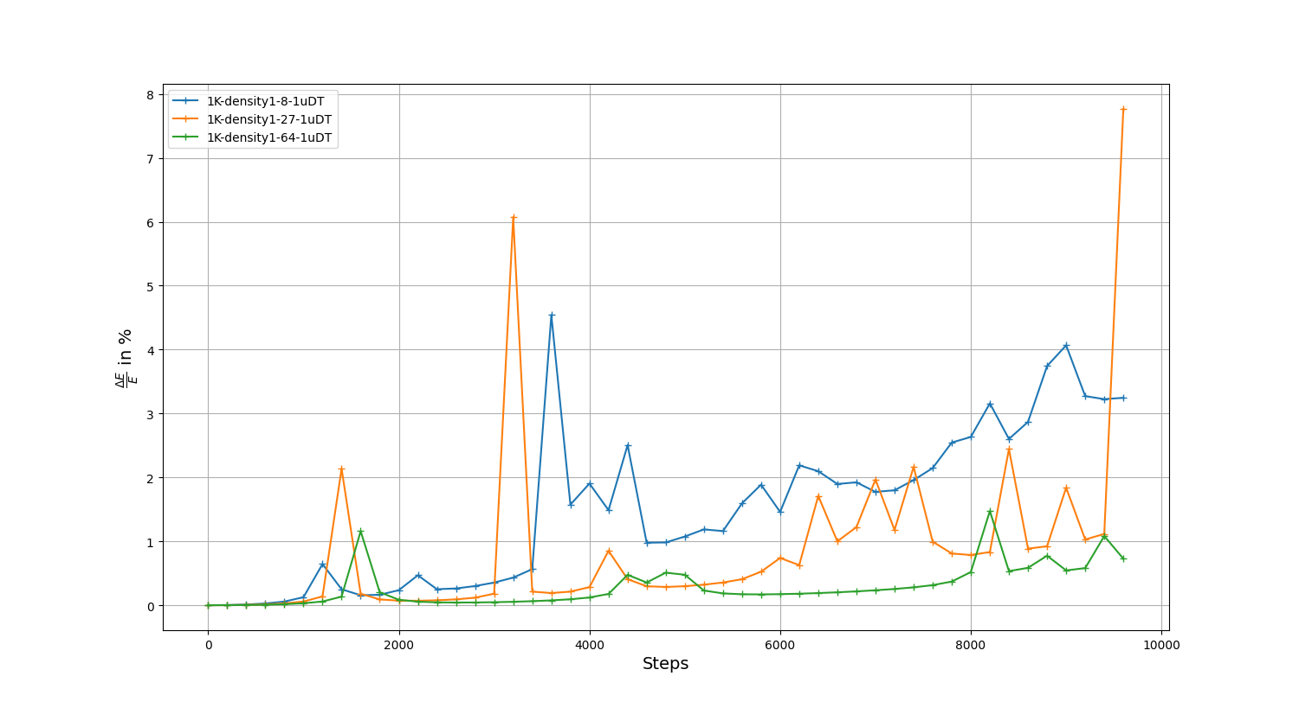
Energy conservation for different particle densities
Written Code

Slide 28
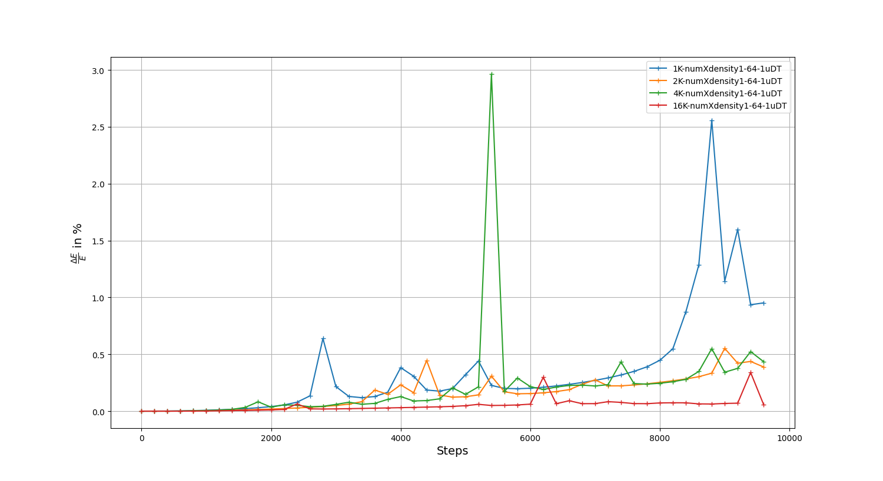
Energy conservation for different particle numbers
Written Code

Slide 29
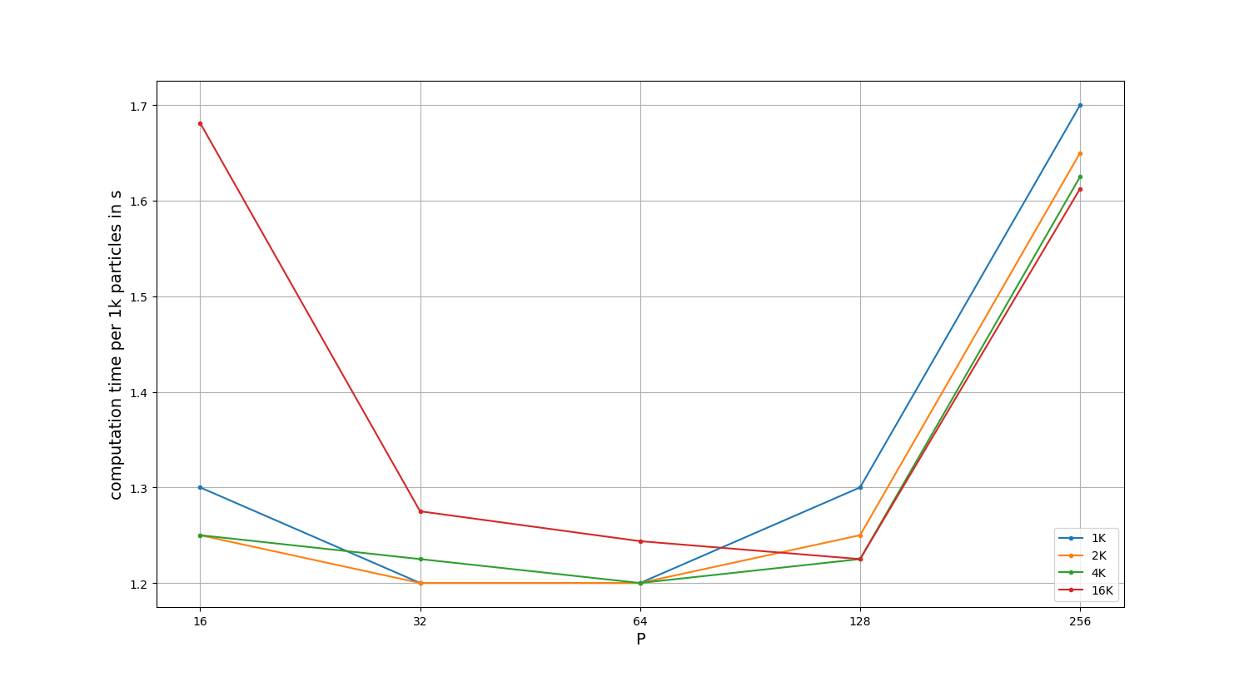
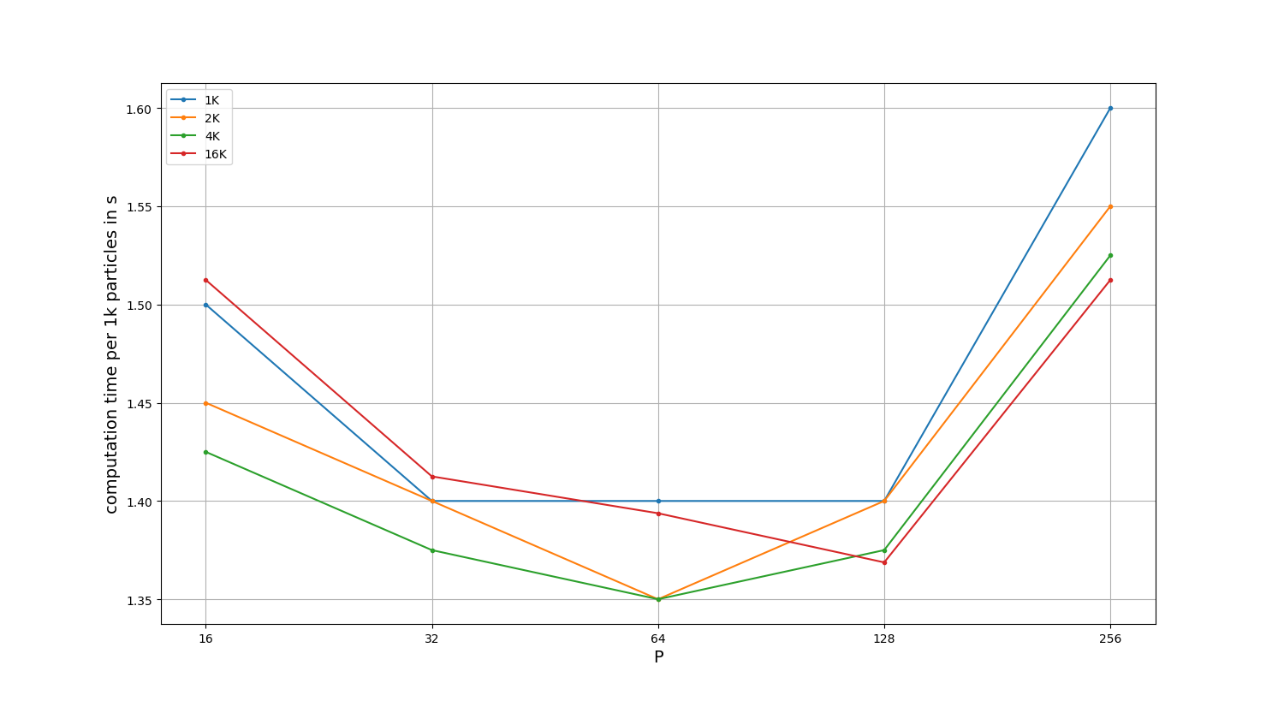
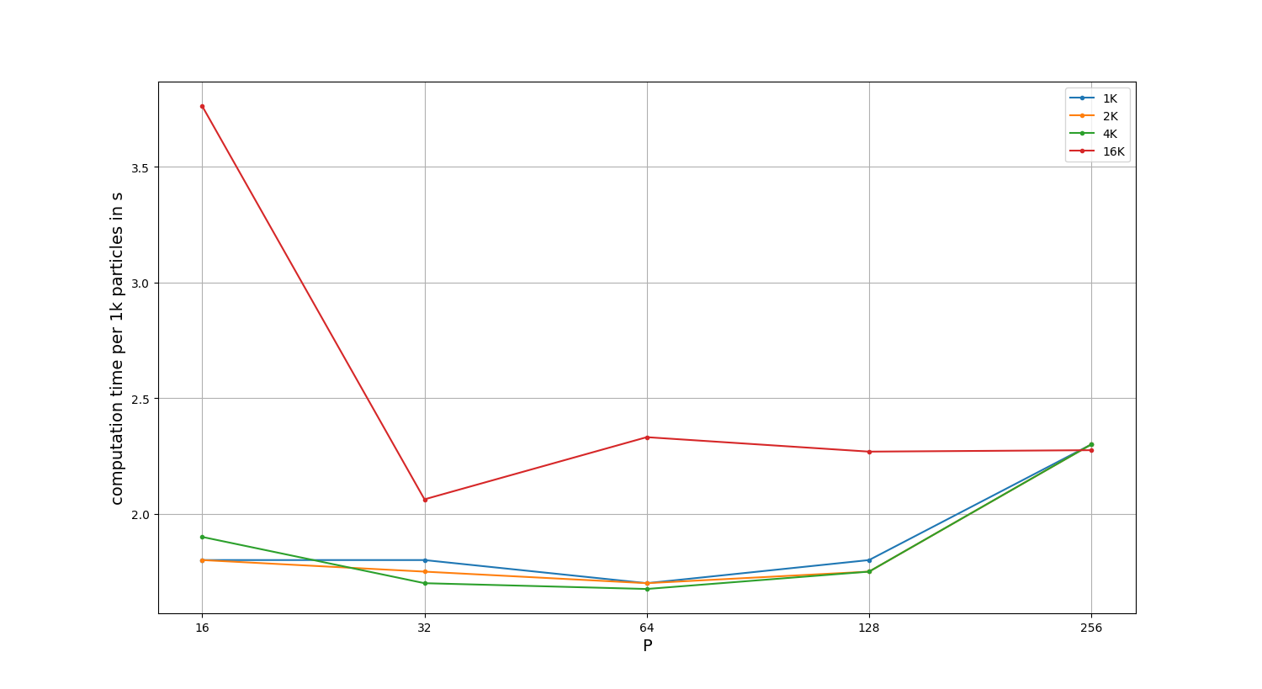
Determining the tile size / block size
4090
5090
3080Ti
Written Code
Notes:
Smaller P:
-better usage of free processors
-more synchronization of threads inside a block
Larger P:
-higher data reuse
-more shared memory usage
-larger blocks can not be started if the space is not there
→ Used size 64

Slide 30
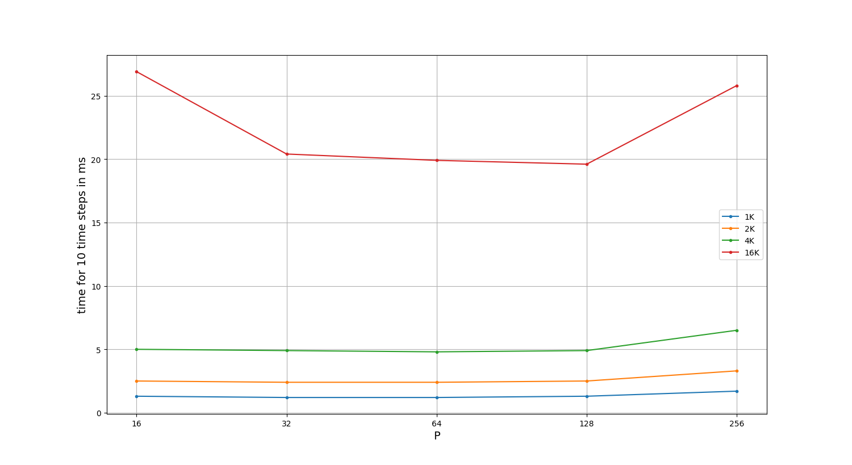
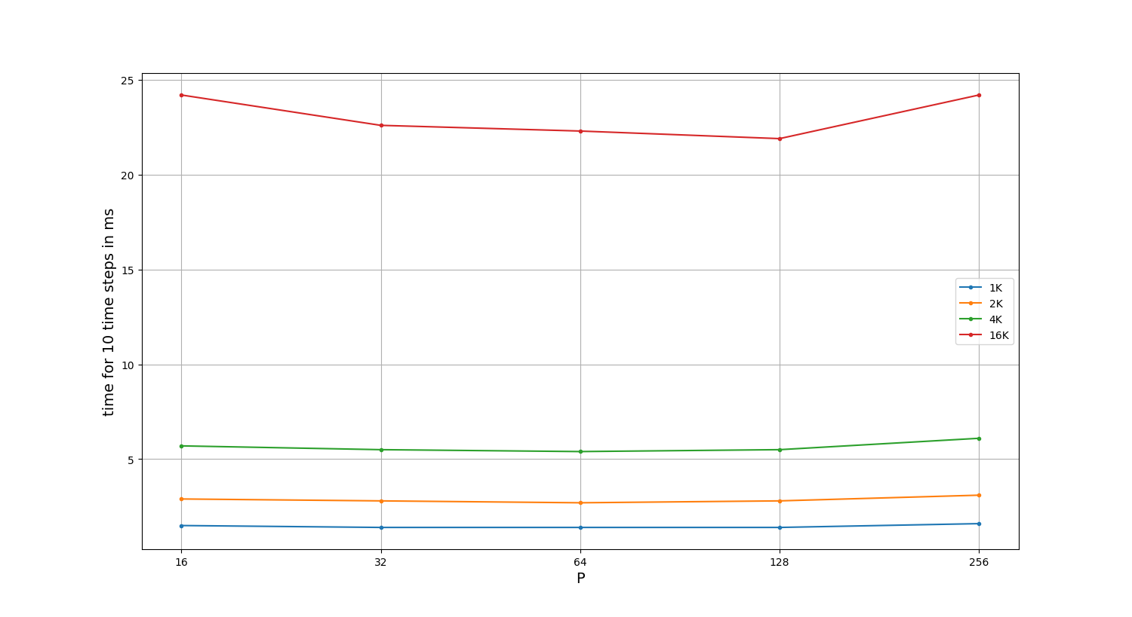
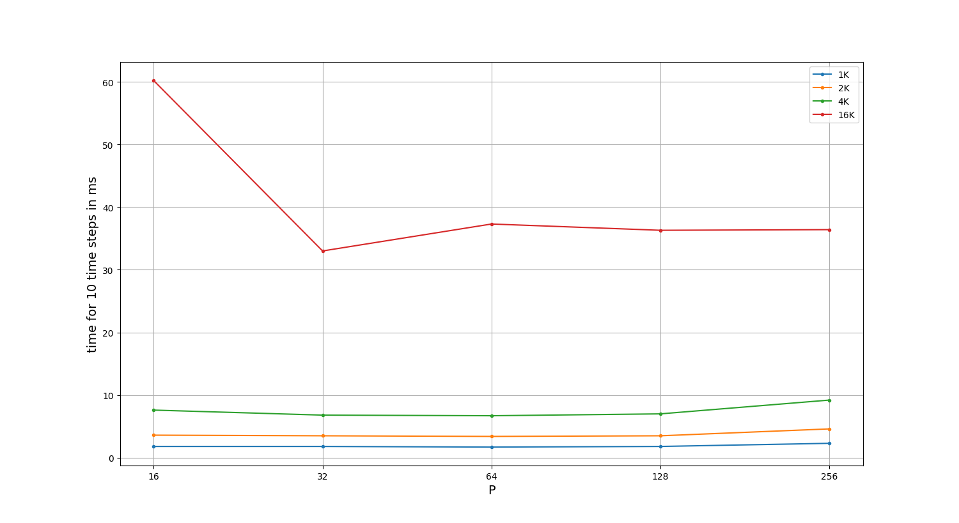
Determining the tile size / block size
4090
5090
3080Ti
Written Code

Slide 31
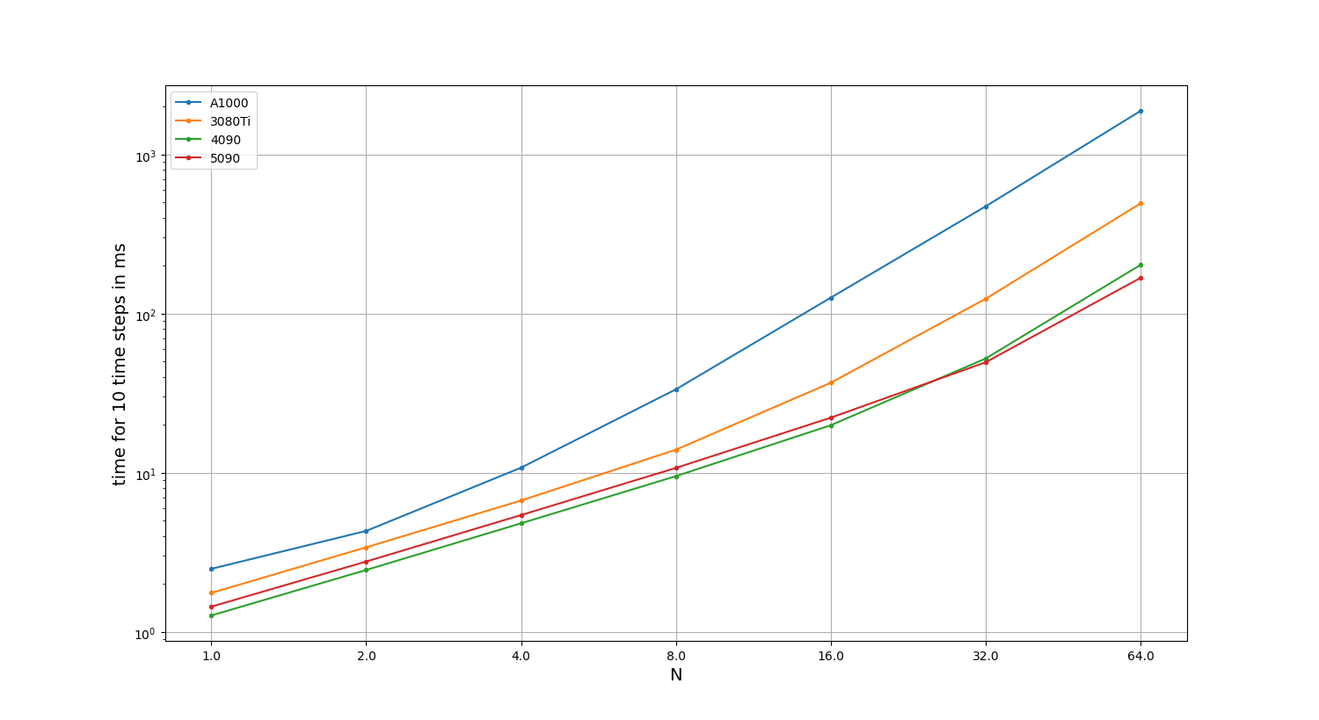
Performance comparison between GPUs
Written Code

Slide 32
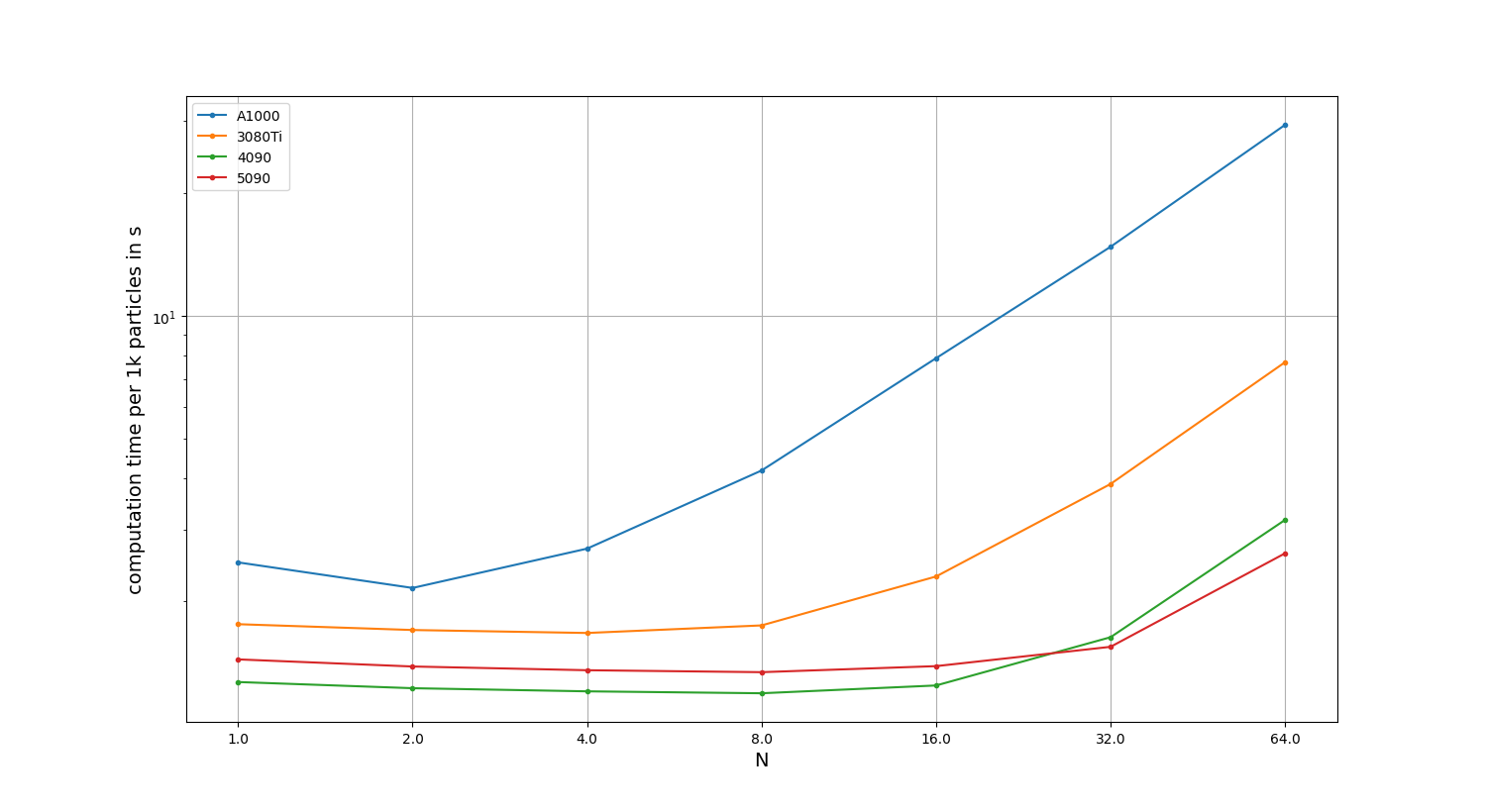
Performance comparison between GPUs
2 304
10 240
21 760
16 384
Written Code
Notes:
See the computation time “costs” for 1k Particles
As N increases more cores are running, but at some point limit is reached.
Note:
Cuda-Cores

Slide 33

Visual Examples

Slide 34
References
[1] https://developer.nvidia.com/gpugems/gpugems3/part-v-physics-simulation/chapter-31-fast-n-body-simulation-cuda

